Slide 1

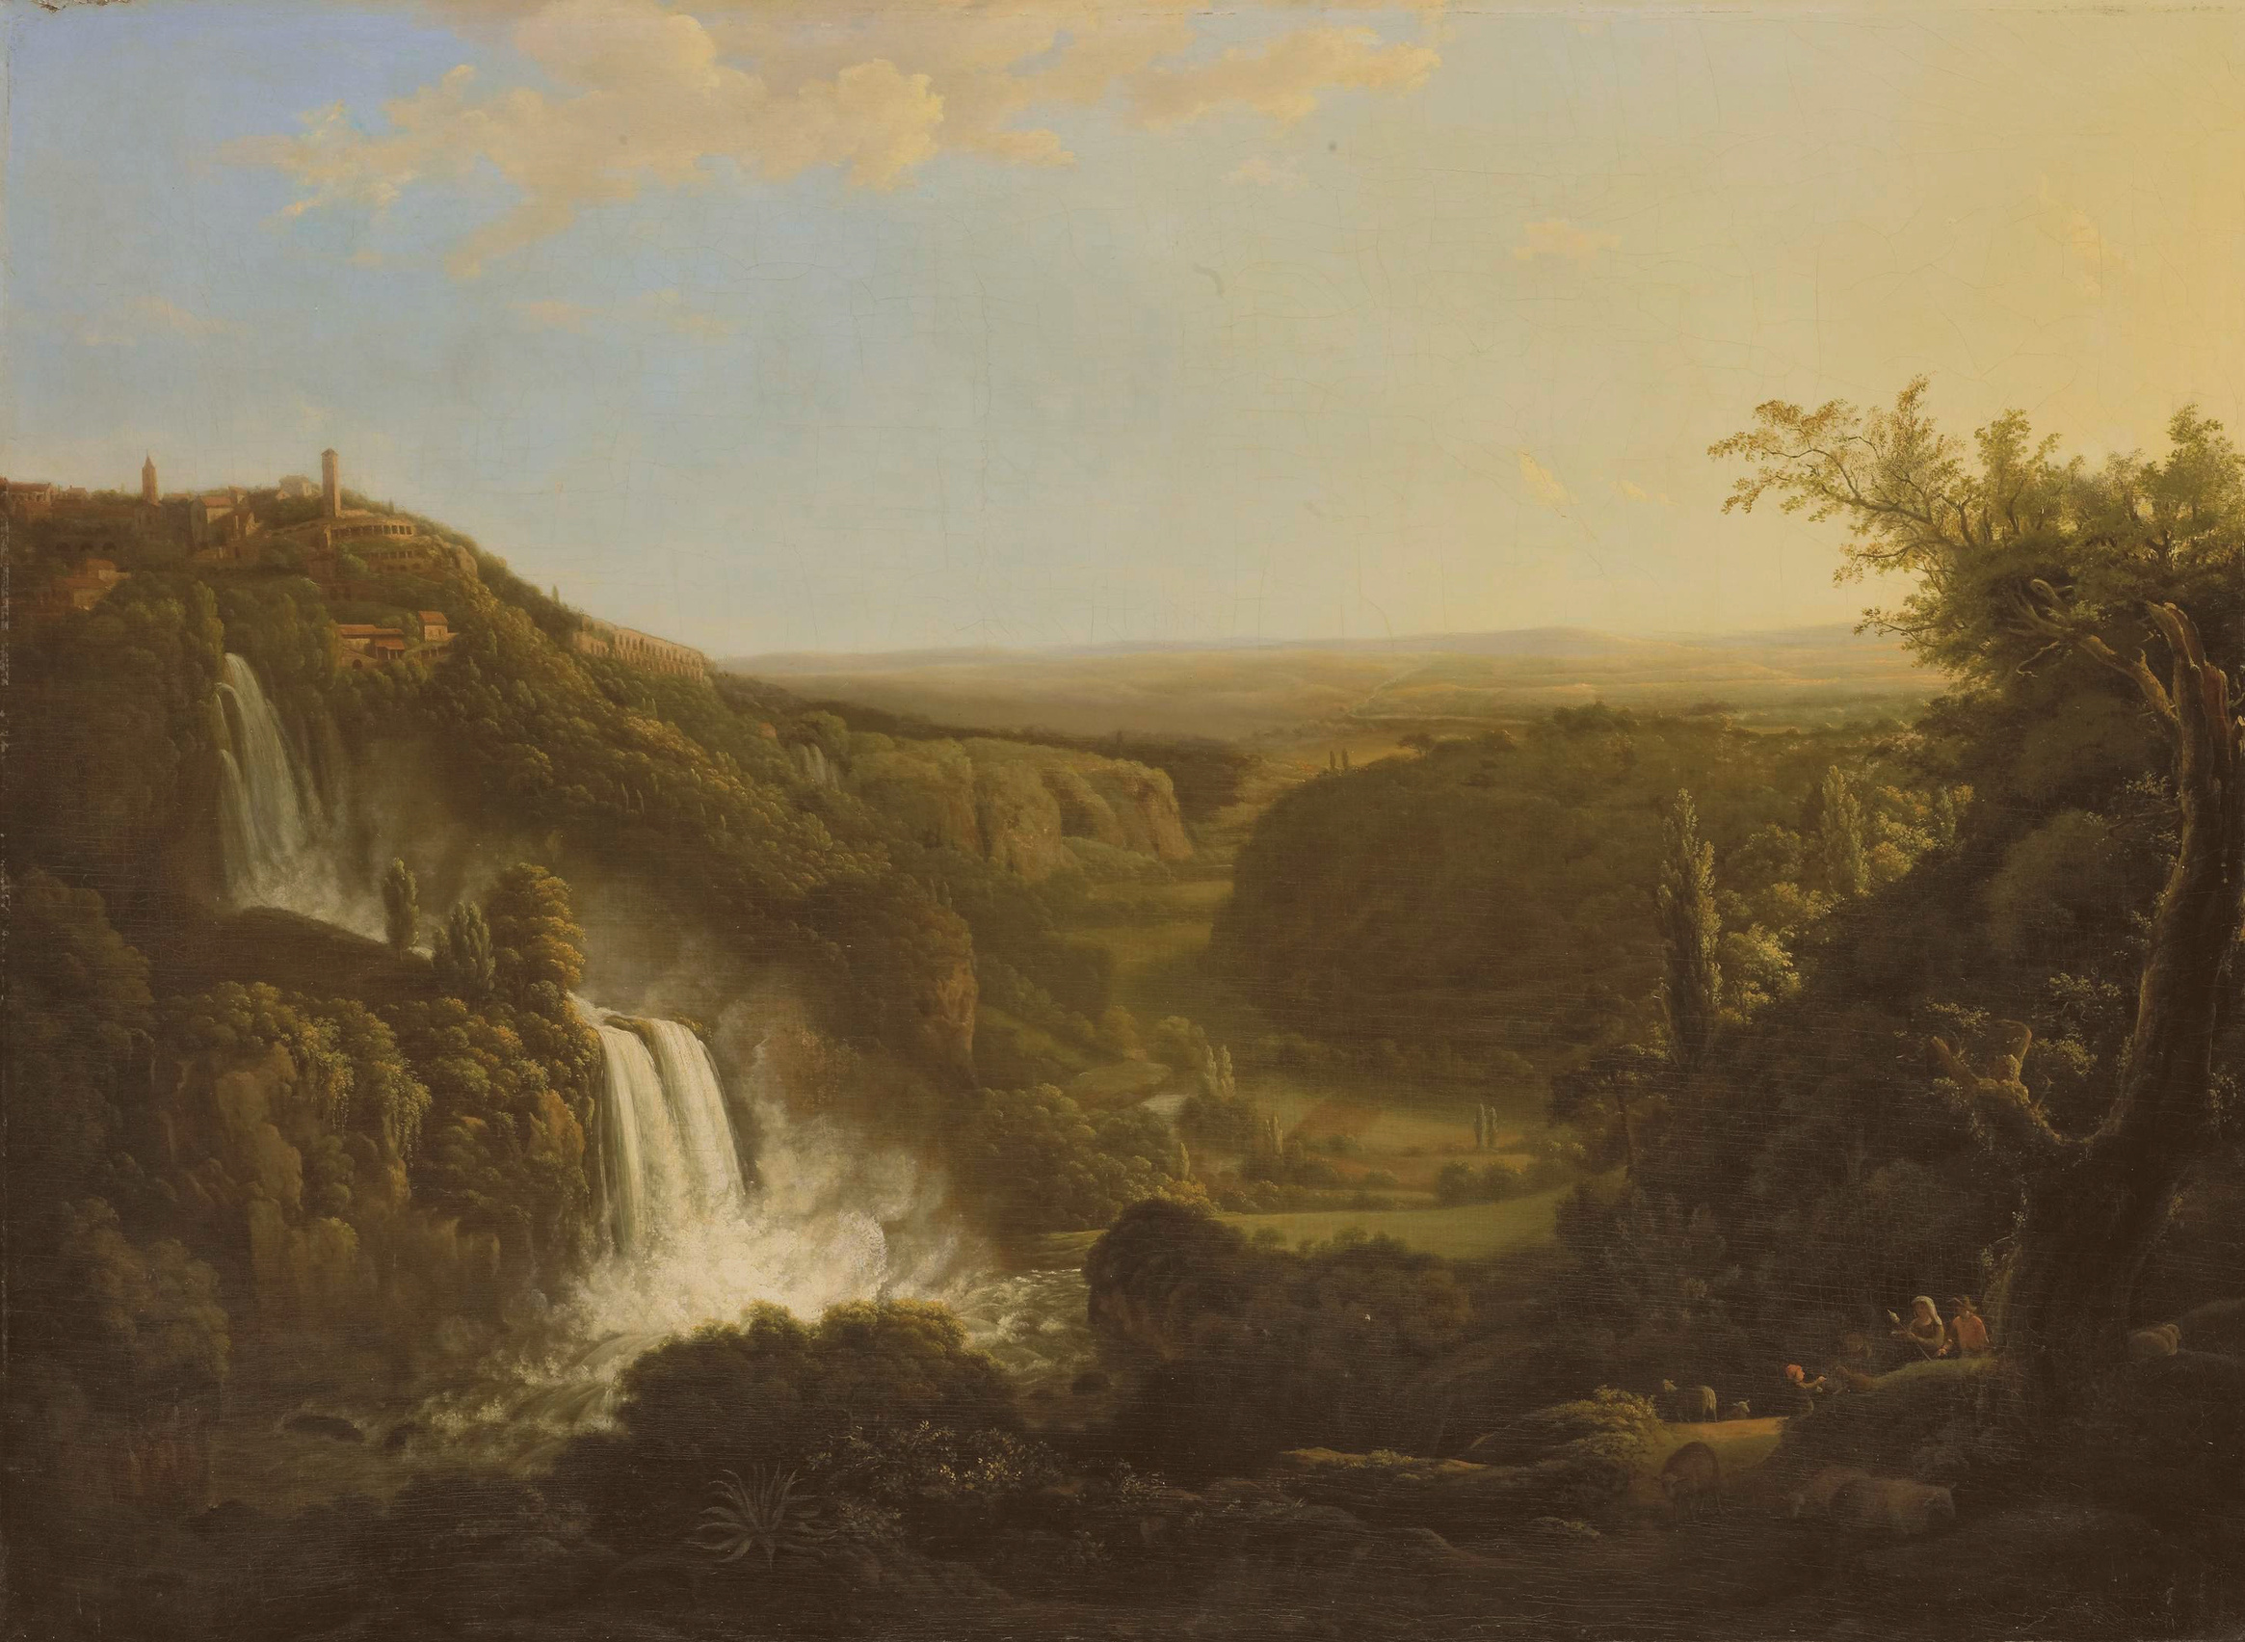

What does it mean to be human?
Birth, life and death in the age of the machine
Chine McDonald
Limborough Lecture 2026

Slide 2
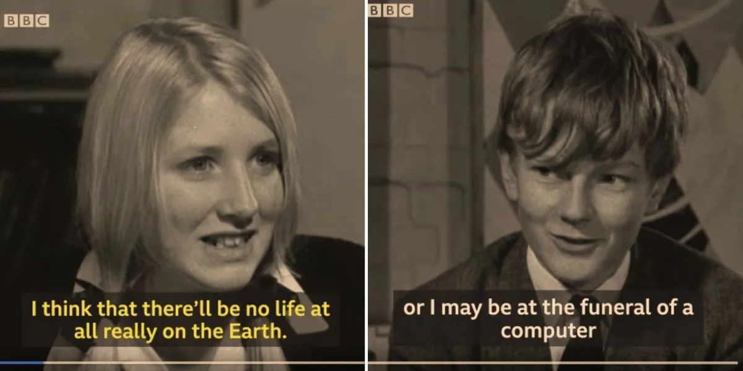

Slide 3
Birth
“Every child born into the world is nature’s attempt at making a perfect human being.”
George Bernard Shaw

Slide 4
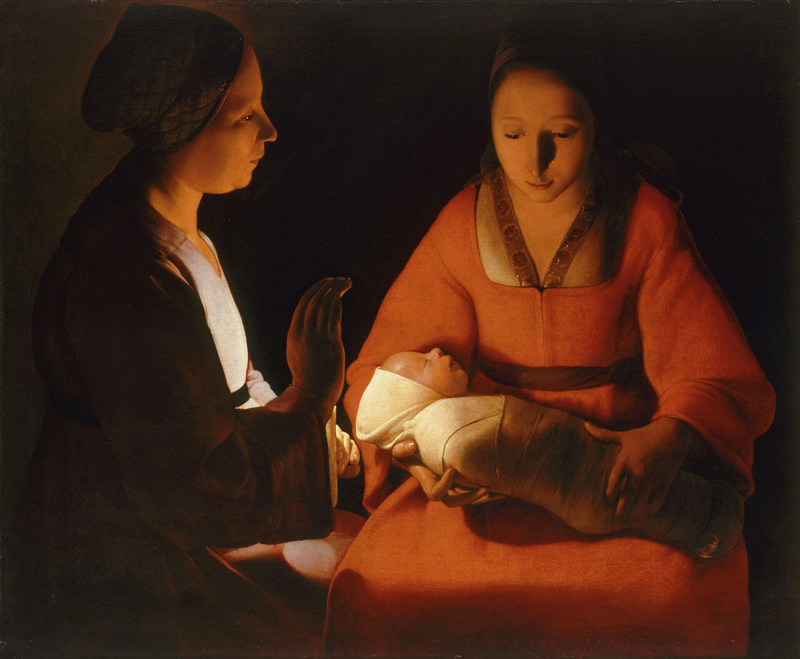
The Newborn Child/The Nativity, Georges de la Tour, 1645-1648

Slide 5
Life
“I have come in order that you might have life--life in all its fullness.”
John 10:10

Slide 6
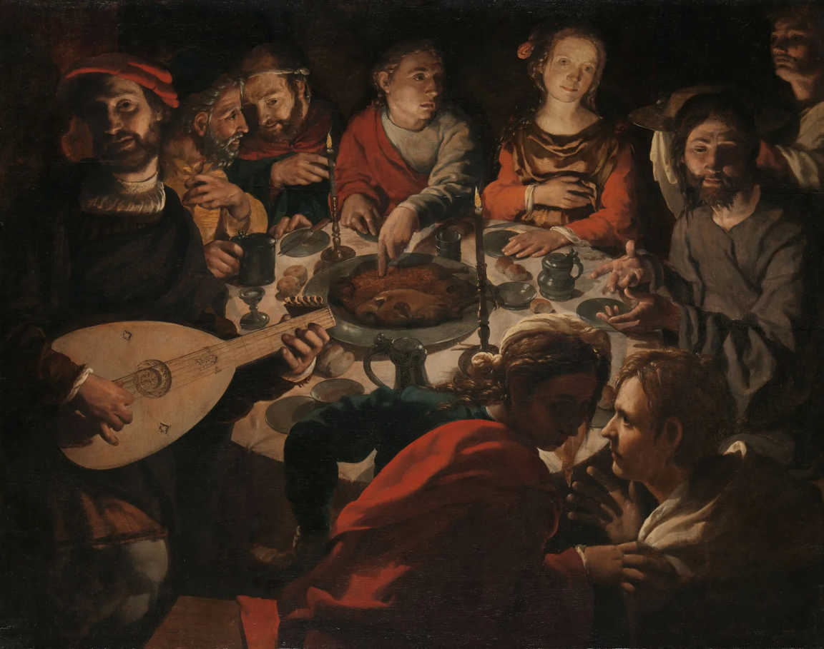
The Wedding at Cana, Jan Cornelisz Vermeyen, 1530

Slide 7
Death
“This last vigil is a place of accountability, a dawning realisation of the true value of the life that is about to end; a place of watching and listening; a time to contemplate what connects us, and how the approaching separation will change our own lives forever.”
Dr Kathryn Mannix, With the End in Mind

Slide 8
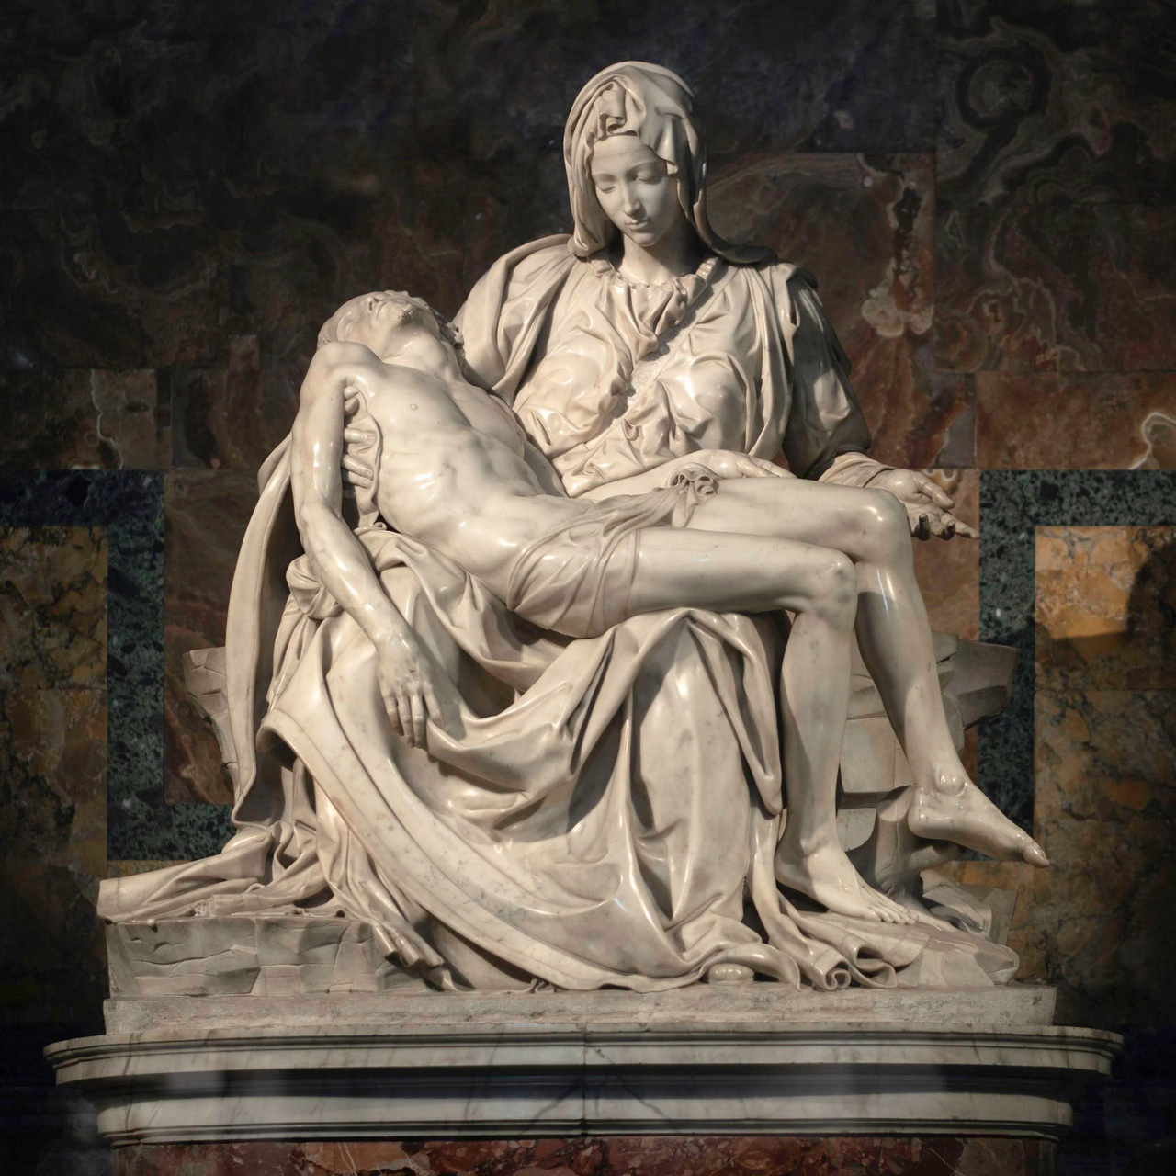
Pieta, Michaelangelo
1498

Slide 9
Death
You only are immortal, the creator and maker of mankind; and we are mortal, formed of the earth, and to earth shall we return. For so did you ordain when you created me, saying, “You are dust, and to dust you shall return.” All of us go down to the dust, yet even at the grave we make our song: Alleluia, alleluia, alleluia.

Slide 10
What does it mean to be human?
“I think being human is learning how to live with the fact that you cannot be enough on your own — and discovering that this is not a tragedy but a gift.”
ChatGPT

Slide 11

What does it mean to be human?

Slide 12
Thank You

